Slide 1
System design and modeling
Part 1: System Modeling

Slide 2
System modeling
System modeling is the process of developing abstract models of a system, with each model presenting a different view or perspective of that system.
System modeling has now come to mean representing a system using some kind of graphical notation, which is now almost always based on notations in the Unified Modeling Language (UML).
System modelling helps the analyst to understand the functionality of the system and models are used to communicate with customers.

Slide 3
Use of graphical models
There are three ways in which graphical models are commonly used:
As a means of facilitating discussion about an existing or proposed system
  Incomplete and incorrect models are OK as their role is to support discussion.
As a way of documenting an existing system
  Models should be an accurate representation of the system but need not be complete. (Because you may only wish to develop models for some parts of a system).
As a detailed system description that can be used to generate a system implementation
  Models have to be both correct and complete.

Slide 4
Existing and planned system models
Models of the existing system are used during requirements engineering. They help clarify what the existing system does and can be used as a basis for discussing its strengths and weaknesses. These then lead to requirements for the new system.
Models of the new system are used during requirements engineering to help explain the proposed requirements to other system stakeholders. Engineers use these models to discuss design proposals and to document the system for implementation.
In a model-driven engineering process, it is possible to generate a complete or partial system implementation from the system model.

Slide 5
System perspectives
An external perspective, where you model the context or environment of the system.
An interaction perspective, where you model the interactions between a system and its environment, or between the components of a system.
A structural perspective, where you model the organization of a system or the structure of the data that is processed by the system.
A behavioral perspective, where you model the dynamic behavior of the system and how it responds to events.

Slide 6
Context models
Context models are used to illustrate the operational context of a system - they show what lies outside the system boundaries.
Social and organisational concerns may affect the decision on where to position system boundaries.
Architectural models show the system and its relationship with other systems.

Slide 7
stem boundaries
Also known as system scope.
System boundaries are established to define what is inside and what is outside the system.
  They show other systems that are used or depend on the system being developed.
The position of the system boundary has a profound effect on the system requirements.

Slide 8
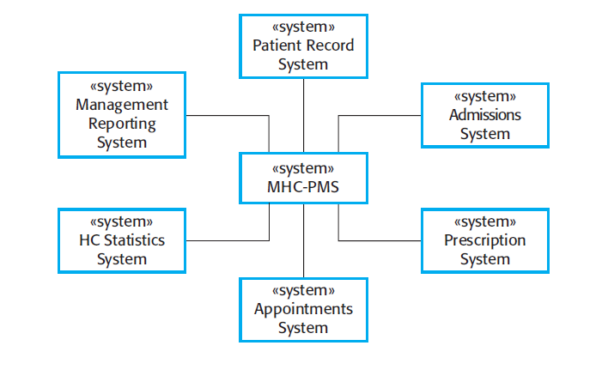
The context of the MHC-PMS

Slide 9
Process perspective
Context models simply show the other systems in the environment, not how the system being developed is used in that environment.
Process models reveal how the system being developed is used in broader business processes.
UML activity diagrams may be used to define business process models.

Slide 10
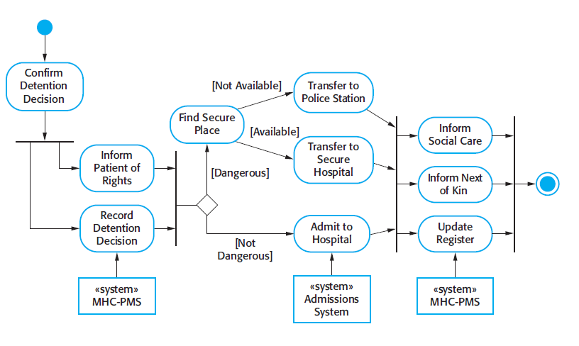
Process model of involuntary detention

Slide 11
Structural models
Structural models of software display the organization of a system in terms of the components that make up that system and their relationships.
Structural models may be static models, which show the structure of the system design, or dynamic models, which show the organization of the system when it is executing.
You create structural models of a system when you are discussing and designing the system architecture.

Slide 12
Behavioral models
Behavioral models are models of the dynamic behavior of a system as it is executing. They show what happens or what is supposed to happen when a system responds to a stimulus from its environment.
You can think of these stimuli as being of two types:
  Data-driven models: Some data arrives that has to be processed by the system.
  Events-driven models: Some event happens that triggers system processing. Events may have associated data, although this is not always the case.

Slide 13
Uml basics
The Unified Modelling Language, or the UML, is a graphical modelling language.
UML is for visual modelling.
Provides us with a syntax for describing the major elements in software engineering projects.
Rational Unified Process is the model implemented

Slide 14
UNIFIED PROCESS model
The Unified Software Development Process or Unified Process is a popular iterative and incremental software development process model for OOD systems.
It is an extensible framework which should be customized for specific organizations or projects.
Has all necessary tools, documentation and procedures for software development.

Slide 15
NEED FOR UNIFIED LANGUAGE
Other industries have languages and notations, which are understood by every member of that particular field.
Mathematicians have a common language.
So do musicians, electronic engineers, and many other disciplines and professions.
Software Engineering has lacked such a notation.
In the past more than 50 software modelling languages were in common use.
Each of them carrying their own notations!
Each language contained syntax peculiar to itself.

Slide 16
NEED FOR UNIFIED LANGUAGE
Today, UML is one of the most widespread graphical object-oriented modeling languages.
UML is simply a language, a notation, a syntax, whatever you want to call it. Crucially, it does not tell you how to develop software.
The first thing to notice about the UML is that there are a lot of different diagrams (models) to get used to.
The reason for this is that it is possible to look at a system from many different viewpoints.
A software development will have many stakeholders playing a part for:

Slide 17
Building blocks
UML is composed of three main building blocks, i.e. things, relationships, and diagrams.
Building blocks generate one complete UML model diagram by rotating around several different blocks.
Things
Relationships
Diagrams

Slide 18
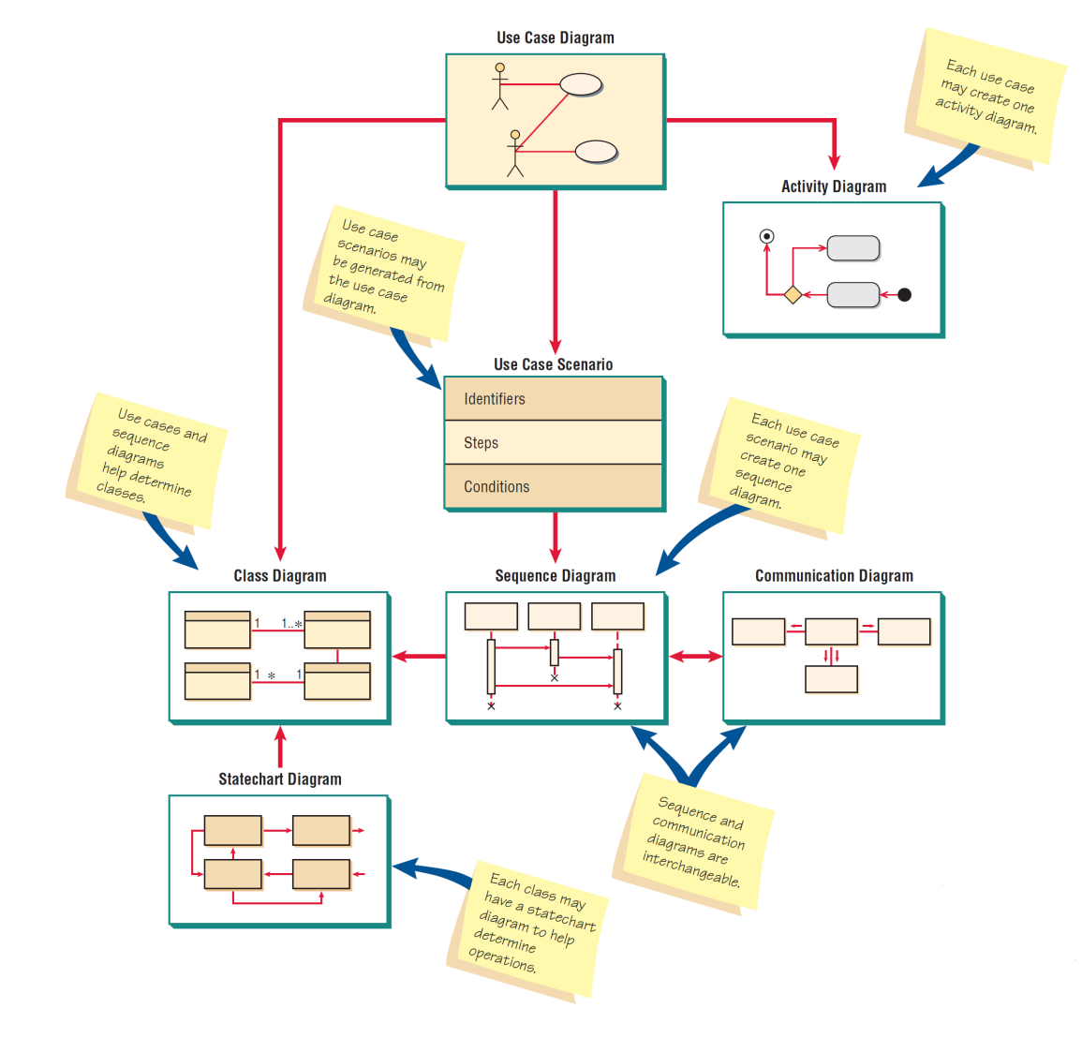
Building blocks

Slide 19
UML diagram
Structural Diagrams (Static)
Behavioral Diagrams (Dynamic)

Slide 20
Structural Diagrams (Static)
Structural things are the nouns of UML models. These are the mostly static parts of a model, representing elements that are either conceptual or physical.
They display the physical and conceptual components of the system.
They include class, object, interface, node, collaboration, component

Slide 21
Behavioral Diagrams (Dynamic)
Behavioral things are the dynamic parts of UML models.
These are the verbs of a model, representing behavior over time and space.
In all, there are three primary kinds of behavioral things.
Interaction.
State machine.
Activity.
Sequence
Usecase

Slide 22
Use Case Diagram
Describes what the system does, without describing how the system does it
Each use case represents a discrete task that involves external interaction with a system.
Actors in a use case may be people or other systems.
Represented diagrammatically to provide an overview of the use case and in a more detailed textual form.

Slide 23
Use Case Diagram
A set of ACTORS : roles users can play in interacting with the system.
  An actor is used to represent something that users our system.
A set of USE CASES: each describes a possible kind of interaction between an actor and the system.
  Uses cases are actions that a user takes on a system
A number of RELATIONSHIPS between these entities (Actors and Use Cases).
  Relationships are simply illustrated with a line connecting actors to use cases.

Slide 24
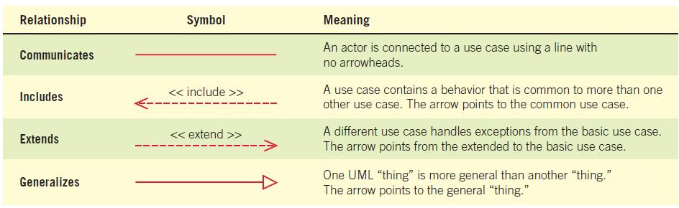
Use case relationships

Slide 25
Modeling use cases
  Note that no order is imposed in use diagrams.
    We handle that in a different, later diagram.
  You can think of this as a high level overview of your user interface.
    You need to permit ways for people to do all of the things you’ve indicated on the diagram.
  Generating the use case diagram will be a result of interaction with the users and the system.
  We can use a technique called event decomposition to arrive at a list of candidate events for our system.
    We treat the system as a black box
    We focus on the things that happen to the black box.
  We may end up discarding or combining the events that we come up with.
    That’s all part of the iterative process.
    What we need to begin with is a starting point.

Slide 26
System events
  There are three main kinds of event we need to look at.
    External events
    Temporal events
    State events
  We consider each of these events in relation to the potential actor.
    This technique is merely a way of focusing our thinking.
    The starting point will still be the problem statement or the users.

Slide 27
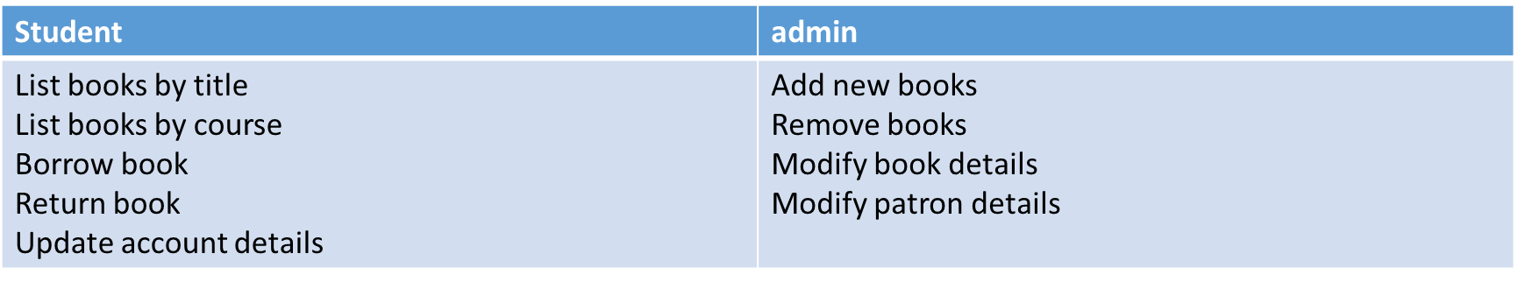
External Events
  External events exist outside the system, and are usually initiated by a third party outside the scope of our system.
    For example, the users of Library, or the database administrator .
  We then document all of the potential interactions that each of these actors may be required to perform.
    Each of these then becomes a candidate for a use case diagram.

Slide 28
Temporal Events
  Temporal events are those that occur as a result of reaching a particular point in time.
    End of the month, so handle salaries
  Sometimes these events will be triggered by external entities
    A user may set up an report that should be mailed to them every week
  We determine temporal events by detailing any specific deadlines or recurring functionality.

Slide 29
State Events
  State events are those that occur when the data in a system reaches a point where processing is required.
    When stock drops below a certain amount, email the procurement department.
  Normally these occur as a result of other events.
    Temporal or state
    A customer buys a product, which adjusts the stock, which throws up a state event.
    Mostly these will lead to state machine diagrams.
  What we get out of this is a list of candidates.
    They’re not all going to be worthwhile.
  The only ones we care about are those that directly affect our system.
  We need to strive for a consistent level of detail across the events.
    This may involve breaking some out into multiple events, or combining others.

Slide 30
Sequence diagrams
A sequence diagram simply depicts interaction between objects in a sequential order i.e. the order in which these interactions take place.
We can also use the terms event diagrams or event scenarios to refer to a sequence diagram.
Sequence diagrams describe how and in what order the objects in a system function.
These diagrams are widely used by businessmen and software developers to document and understand requirements for new and existing systems.

Slide 31
benefits
Represent the details of a UML use case.
Model the logic of a sophisticated procedure, function, or operation.
See how objects and components interact with each other to complete a process.
Plan and understand the detailed functionality of an existing or future scenario.

Slide 32
Notations
  Sequence diagrams consist of a number of lifelines.
    These are boxes that represent the roles and lifetimes of objects involved in an interaction.
  Each of these life-lines will produce messages.
    These are labelled arrows that show the name of methods invoked and their parameters.
  Return messages are drawn with the type of the parameter, and a dotted arrow
  The flow of logic through a sequence diagram is often dependent on the state of returned values.
    Card validity
    Book availability
  We represent these in a sequence diagram through the use of a frame.
    This allows us to provide if/else structures in our diagrams.
    We place a guard condition on the frame which determines whether a frame should be executed

Slide 33
notations
  In a sequence diagram, the boxes at the top of a lifeline represent objects.
    Not classes.
  As such, they should properly be named and typed.
    Names are of secondary importance unless we can be sure of a particular context.
  We name them anyway so that we can distinguish between instances of a class and potentially static operations (in which case, we have the type only).
  Actors – An actor in a UML diagram represents a type of role where it interacts with the system and its objects. It is important to note here that an actor is always outside the scope of the system we aim to model using the UML diagram.

Slide 34
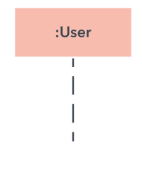
notations
Lifelines – A lifeline is a named element which depicts an individual participant in a sequence diagram. So basically each instance in a sequence diagram is represented by a lifeline. Lifeline elements are located at the top in a sequence diagram.
A lifeline always portrays an object internal to the system whereas actors are used to depict objects external to the system.

Slide 35
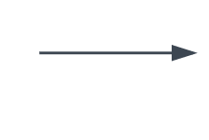

Messages – Communication between objects is depicted using messages. The messages appear in a sequential order on the lifeline. We represent messages using arrows. Lifelines and messages form the core of a sequence diagram.
Recursive Message: A self message sent for recursive purpose is called a recursive message. In other words, it can be said that the recursive message is a special case of the self message as it represents the recursive calls.

Slide 36
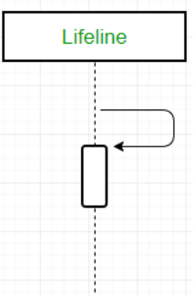
messages
Self Message – Certain scenarios might arise where the object needs to send a message to itself. Such messages are called Self Messages and are represented with a U shaped arrow.

Slide 37

notations
Activation box:
Represents the time needed for an object to complete a task. The longer the task will take, the longer the activation box becomes.

Slide 38
How to Draw a Sequence Diagram
A sequence diagram represents the scenario or flow of events in one single use case. The message flow of the sequence diagram is based on the narrative of the particular use case.
Then, before you start drawing the sequence diagram or decide what interactions should be included in it, you need to draw the use case diagram and ready a comprehensive description of what the particular use case does.

Slide 39
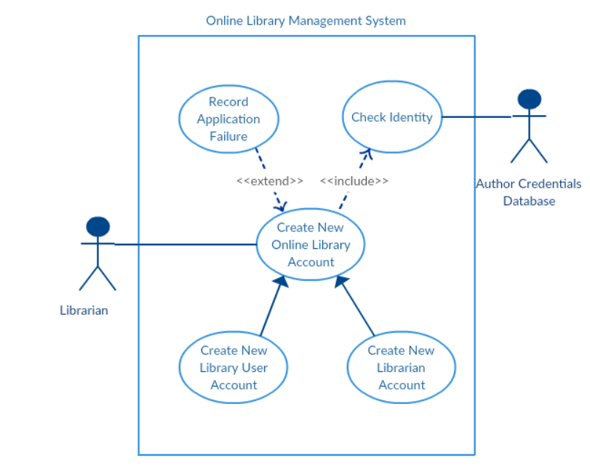
Library system

Slide 40
Based on previous slide
From the above use case diagram example of ‘Create New Online Library Account’, we will focus on the use case named ‘Create New User Account’ to draw our sequence diagram example.
Before drawing the sequence diagram, it’s necessary to identify the objects or actors that would be involved in creating a new user account. These would be:
Librarian
Online Library Management system
User credentials database
Email system

Slide 41
Once you identify the objects, it is then important to write a detailed description on what the use case does.
From this description, you can easily figure out the interactions (that should go in the sequence diagram) that would occur between the objects above, once the use case is executed.

Slide 42
steps
Here are the steps that occur in the use case named ‘Create New Library User Account’.
The librarian request the system to create a new online library account
The librarian then selects the library user account type
The librarian enters the user’s details
The user’s details are checked using the user Credentials Database
The new library user account is created
A summary of the of the new account’s details are then emailed to the user

Slide 43
Final product
From each of these steps, you can easily specify what messages should be exchanged between the objects in the sequence diagram. Once it’s clear, you can go ahead and start drawing the sequence diagram.

Slide 44
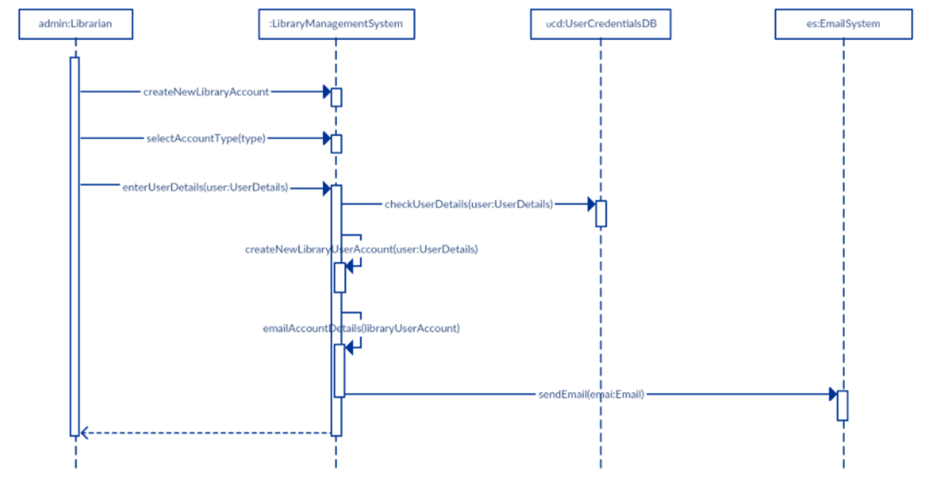
Final product

Slide 45
Class diagrams
Depict high level objects of the system.
  The most difficult thing when it comes to building class diagrams is working out which classes to include.
  Usually we progress from a problem statement or a requirements specification.
  There are formal techniques that aid in identifying classes.
  We’ll look at one called Natural Language Analysis.
  We apply this heuristic process to a description of a problem

Slide 46
nla
  Natural language analysis permits us to obtain a list of candidate classes, their relationships and their attributes.
  Natural Language Analysis (NLA) is the process of identifying verbs, adjectives and nouns in a piece of descriptive text.
    Nouns relate to potential classes
    Adjectives relate to potential attributes
    Verbs relate to potential functionality that must be represented.

Slide 47
Process for identifying classes
  We take a piece of text and identify each of these in turns, creating lists.
    Not everything we identify will be useful or relevant.
    That is why they are candidates.
  Once we have our lists, we get rid of:
    Duplicates
    Irrelevancies
    Candidates that are out-with our project scope
  What we end up with is a ‘first draft’ of a representation of the system.

Slide 48
Example
We need a system that allows us to manage our library. It needs to let us add, remove and manipulate books, as well as add, remove and manipulate student details. It should keep a database of all the books that are available on the shelves and those that are in the storeroom. Students and lecturers should be able to view our catalogue through a webpage and place holds on the books that they wish to reserve.

Slide 49
Nouns
We need a system that allows us to manage our library. It needs to let us add, remove and manipulate books, as well as add, remove and manipulate customer details. It should keep a database of all the books that are available on the shelves and those that are in the storeroom. Patrons should be able to view our catalogue through a webpage and place holds on the books that they wish to reserve.

Slide 50
verbs
We need a system that allows us to [manage] our library. It needs to let us [add], [remove] and [manipulate] books, as well as [add], [remove] and [manipulate] customer details. It should [keep] a database of all the books that are available on the shelves and those that are in the storeroom. patrons should be able to [view] our catalogue through a webpage and [place] holds on the books that they wish to reserve.

Slide 51
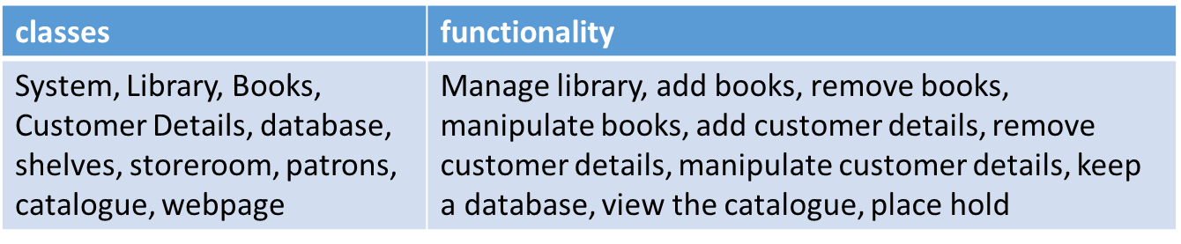
Candidates
  This gives us an initial list of possible classes and actions:

Slide 52
Class diagram development
  Having been given a list of classes and actions, we need to assign actions to classes.
    We can use this to build up our first class representation.
  Assigning functionality can be difficult.
    We want it to be stored as close to the data that it is using as possible.
    We want it to be stored in as high a level of abstraction as it can to ensure maximum maintainability.
  Constructing the class diagram will help refine our candidates.
    If we have a class that has no functionality or data associated with it, we probably don’t need it.
  If we have a class that contains only one single piece of data, it is probably better represented as an attribute in another class.
    At this point, we are still on the first draft.
      This is the draft that lets us go back to those for whom we are building the software.

Slide 53
Refining class diagram
  Look at the functionality we have linked to a book.
    Add books (okay)
    Remove books (okay)
    Manipulate books (ambiguous)
  Perhaps that means ‘edit’ book details, but we’d need to check.
  If it means edit the details, what kinds of details do we need?

Slide 54
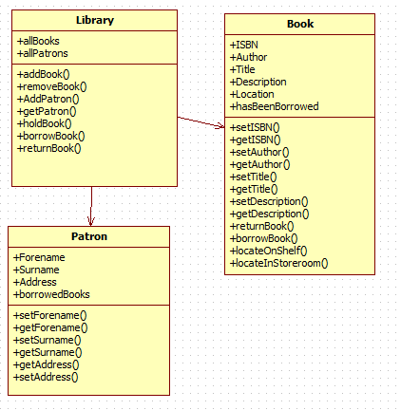
Draft diagram

